Slide 1


Slide 2
Agenda workshop
Keuze ReactJS of Angular
Voordracht ReactJS
Voordracht Angular
Start workshop

Slide 3
Combinaties
ReactJS + AXIOS
Angular + Observables

Slide 4

Notes:
http://coenraets.org/present/react/#3
http://slides.com/alexanderfarennikov/react-js-fundamentals/fullscreen#/20
https://scotch.io/tutorials/learning-react-getting-started-and-concepts

Slide 5
Syntax Component
Class Welcome extends React.Component{
render() {
return <div>Hello {this.props.name}</div>; → JSX
}
}
IN HTML:
<Welcome name="Sara" />
OUTPUT:
Hello Sara
Notes:
You can embed any JavaScript expression in JSX by wrapping it in curly braces.
Conceptually, components are like JavaScript functions. They accept arbitrary inputs (called "props") and return React elements describing what should appear on the screen.
Always start component names with a capital letter.
For example, <div /> represents a DOM tag, but <Welcome /> represents a component and requires Welcome to be in scope.

Slide 6
Component: class
2 types of state:
this.props
Get properties from parent
this.state
Local state within components

Slide 7
export class Welcome extends React.Component {
render( ) {
return <h1>Hello, {this.props.name}</h1>;
}
}
class App extends React.Component {
render( ) {
return (
<div>
<Welcome name="Sara" />
<Welcome name="Cahal" />
<Welcome name="Edite" />
</div>
);
}
}
ReactDOM.render(
<App />, document.getElementById('root')
);
Notes:
Export?

Slide 8
this.props
Never ever changes props!
This is the responsibility for the parent
and not the child

Slide 9
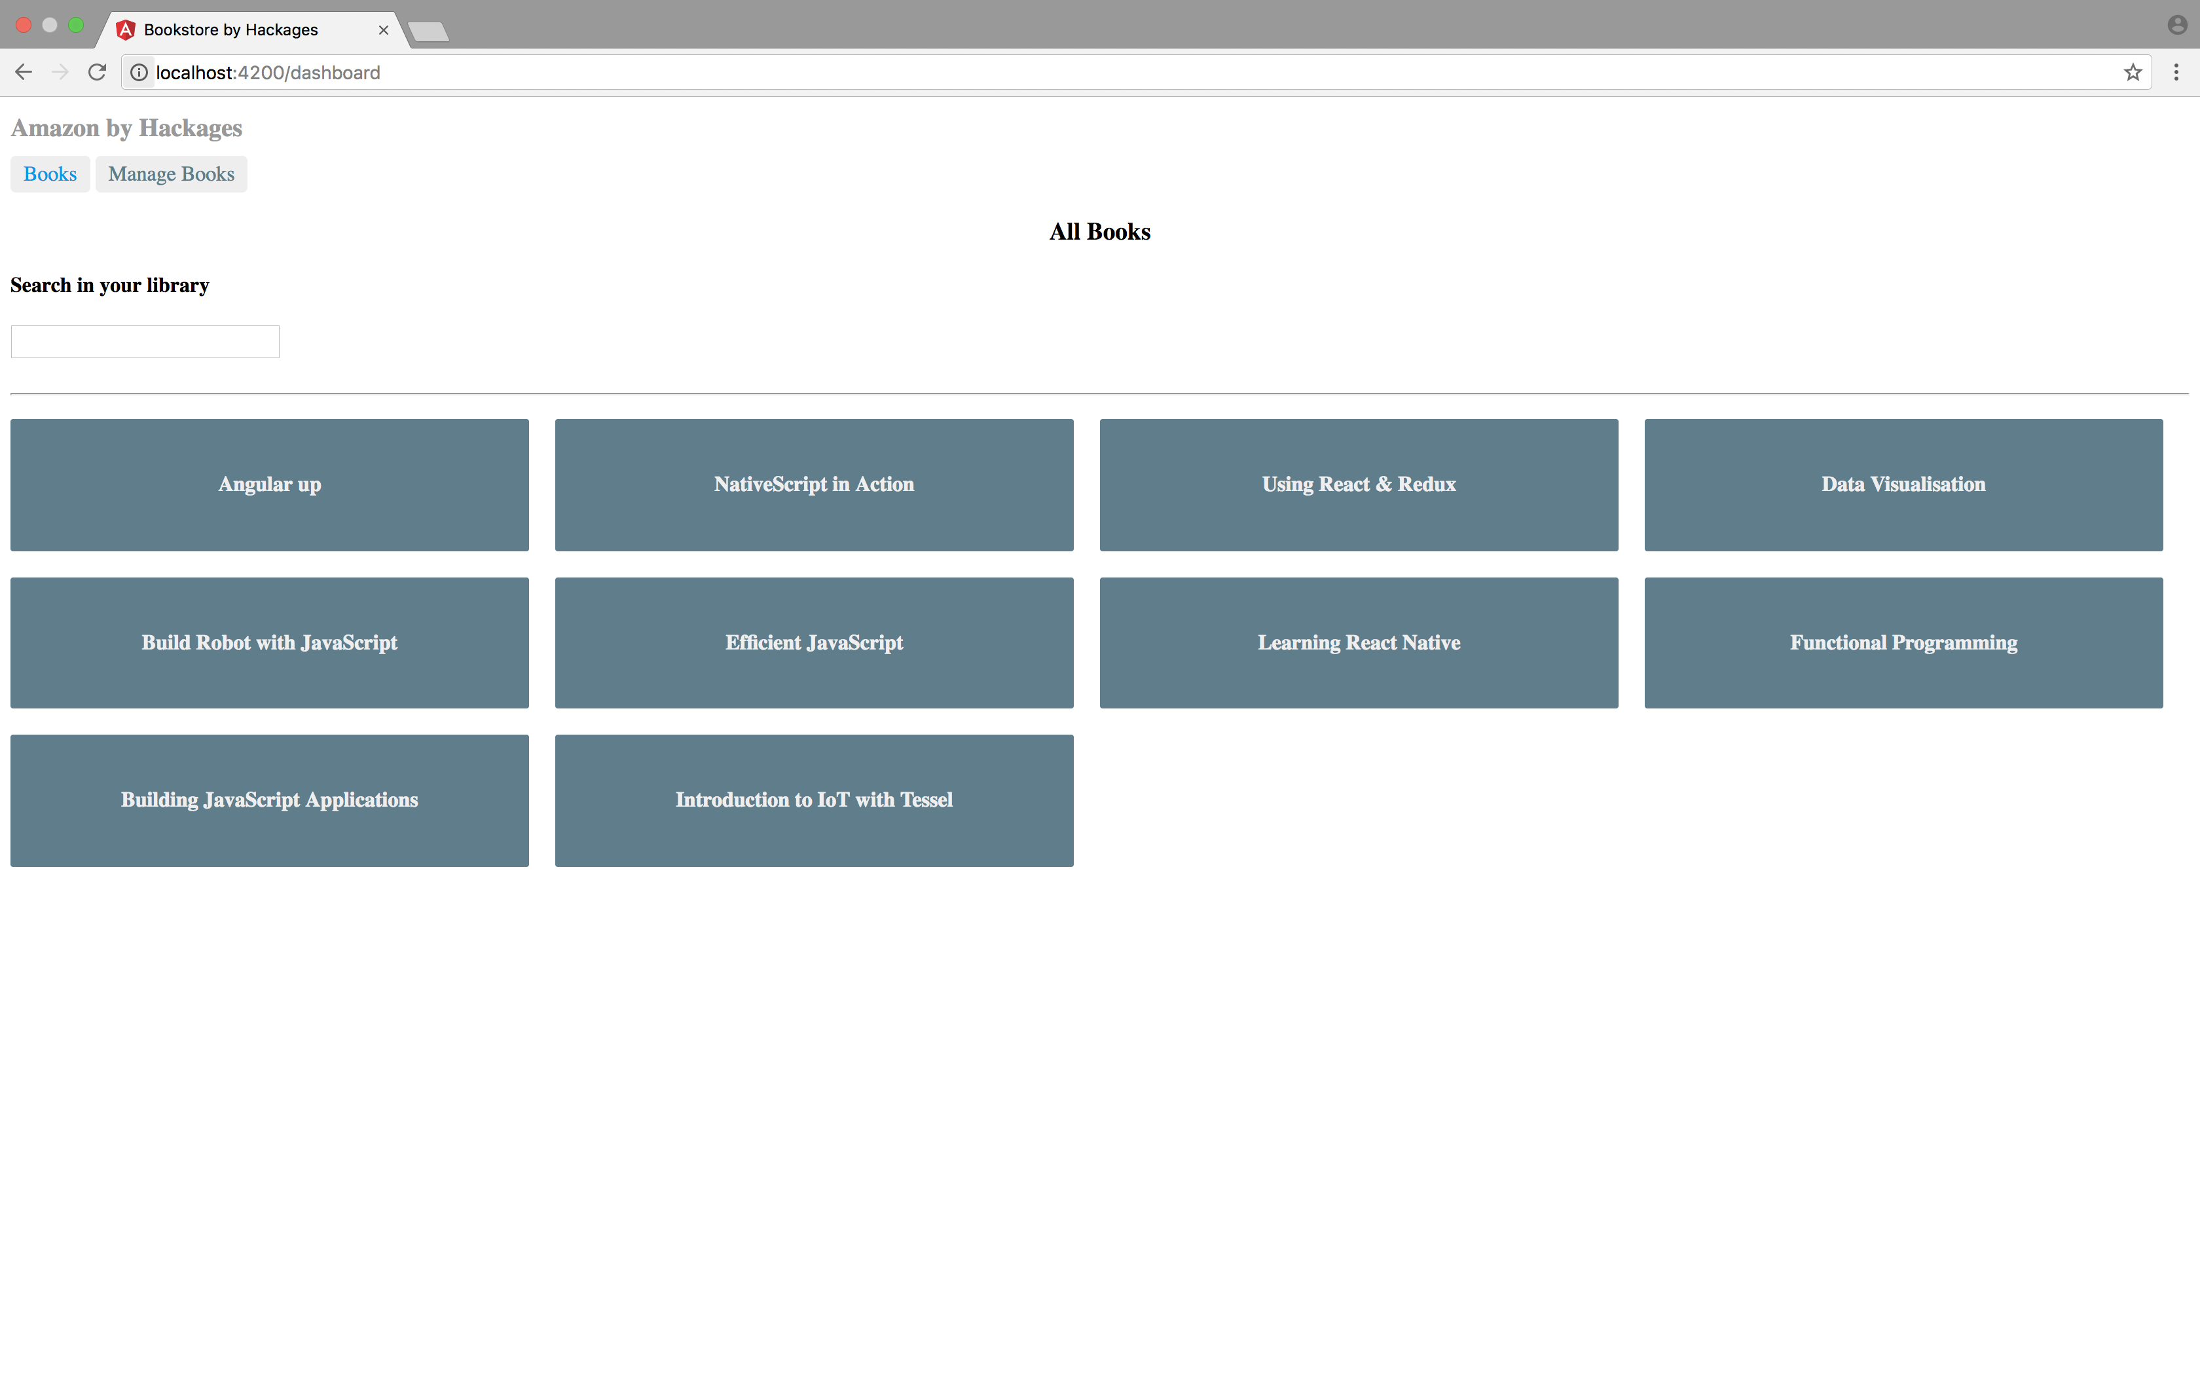
BookSearch and DashBoard

Slide 10
Component based
Index.html
props
AppComponent
props
props
props
BookSearchComponent
DashBoardComponent
BooksComponent
props
props
BookDetalsComponent

Slide 11
Component based
AppComponent
BookSearchComponent
DasboardComponent

Slide 12
Promise Syntax
Service.get()
.then(x => console.log(x))
.catch(error => console.log(error))

Slide 13
BookSearchComponent
export class BookSearch extends React.Component {
constructor(props) {
super(props);
this.state = {
books: [],
}
}
search = (event) => {
axios.get("http://localhost:5000/books/?q=" + event.target.value)
.then((response) => {
this.setState({
books: response.data
})
});
};
Notes:
Set State!
Use AXIOS: Promise based HTTP client for node.js
Use ES6 arrow functions
An arrow function expression has a shorter syntax than a function expression and does not bind its own this.
You can program in an object oriented OR functional way with Arrow functions.

Slide 14
Axios Syntax
axios.get("http://localhost:5000/books/?q=" + searchTerm)
.then((response) => {
this.setState({
books: response.data
})
});
Notes:
AXIOS? = Op async wijze ophalen van data
Use ES6 arrow functions? Je kan op een functionele manier programmeren.

Slide 15
this.setState()
Do not! Change state with this.state = newState.
Use this.setState( )
Otherwise react will not re-render, and possibly overwrite your state.

Slide 16
DashBoardComponent
export class Dashboard extends React.Component {
constructor(props) {
super(props);
this.state = {
books: [‘book1’,’book2’]
}
}
componentDidMount(){
// You should fetch de books from http://localhost:5000/books
// and store them in your state
}
render() {
return (
<div>
<h3>All Books</h3>
<BookSearch />
{this.state.books.map(book => (
<h4>{book}</h4>
))}
</div>
);
}
}
Notes:
Use ES6 arrow functions
An arrow function expression has a shorter syntax than a function expression and does not bind its own this.
You can program in an object oriented OR functional way with Arrow functions.

Slide 17
DashBoardComponent
export class Dashboard extends React.Component {
constructor(props) {
super(props);
this.state = {
books: [ ]
}
}
componentDidMount() {
axios.get("http://localhost:5000/books").then((response) => {
this.setState({
books: response.data
})
});
}
render() {
return (
<div>
<h3>All Books</h3>
<BookSearch />
{this.state.books.map(book => (
<h4>{book.title}</h4>
))}
</div>
);
}
}
Notes:
Zie data.json voor de test data!
Use ES6 arrow functions!

Slide 18
Template literals
var url = 'http://localhost:3000/api/messages/' + id
var url = `http://localhost:3000/api/messages/${id}`

Slide 19
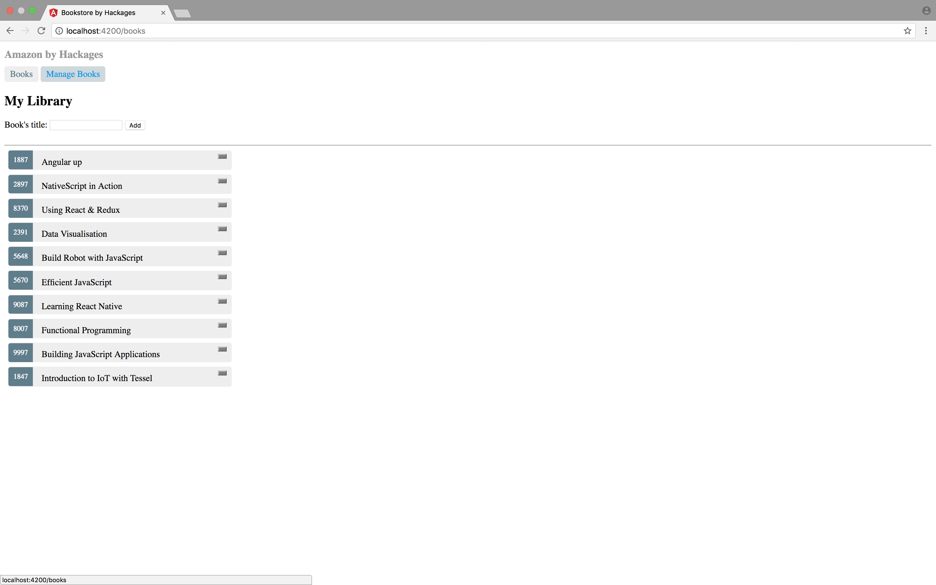
BooksComponent

Slide 20
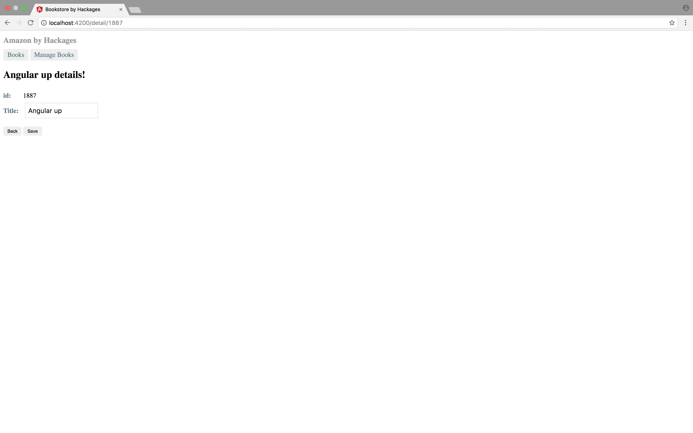
BookDetailComponent

Slide 21
BookDetailComponent
export class BookDetail extends React.Component {
constructor(props) {
}
componentDidMount(){
this.fetchBook(this.props.match.params.id);
}
----
App.js
<Route path="/detail/:id" component={BookDetail} />
Notes:
componentDidMount(){
this.fetchBook(this.props.match.params.id); →
}
https://medium.com/@pshrmn/a-simple-react-router-v4-tutorial-7f23ff27adf
The :number part of the path /roster/:number means that the part of the pathname that comes after /book/ will be captured and stored as match.params.number. For example, the pathname /book/6 will generate a params object :
{ number: '6' } // note that the captured value is a string

Slide 22
Component: lifecycles
Mounting
Updating
Unmounting
Notes:
https://facebook.github.io/react/docs/react-component.html

Slide 23
Component: lifecycles
Mounting:
constructor()
componentWillMount()
render()
componentDidMount()
Notes:
https://facebook.github.io/react/docs/react-component.html

Slide 24
Component: lifecycles
Updating:
componentWillReceiveProps()
shouldComponentUpdate()
componentWillUpdate()
render()
componentDidUpdate()
Notes:
https://facebook.github.io/react/docs/react-component.html

Slide 25
Component: lifecycles
Unmounting:
componentWillUnmount()
Notes:
https://facebook.github.io/react/docs/react-component.html

Slide 26
Additional information
https://facebook.github.io/react/docs/hello-world.html
https://github.com/airbnb/javascript/tree/master/react

